Slide 1
Lecture 15 Sorting
Department of Computer Science
Hofstra University
Acknowledgement: Lecture slides based on UofW Course on Data Structures

Slide 2
Warm Up
If I handed you a stack of papers and asked you to sort them by author name alphabetically, how would you do it?
Selection Sort - Flip through the stack from front to back looking for the first name, then pull it to the front. Then I would flip through again looking for the second name and put it behind the first and so on until all were sorted
Insertion Sort - Look at the first two papers and put them in sorted order, then look at the third and put it in sorted order with the previous two and continue until the whole stack is in sorted order
Merge Sort - Spread the papers out on the ground and break them into subsections, sort the subsections section by section then put them all back together
Bucket Sort - Put the papers into groups based on the first letter of the author’s name until I had 26 piles, then sort within those piles and put them all back together

Slide 3
Intro to Sorting
Selection Sort
Insertion Sort
Merge Sort
Quick Sort
Heap Sort
Bucket Sort
Radix Sort
Sorting Summary

Slide 4
Intro to Sorting

Slide 5
Types of Sorts
Comparison Sort
Compare two elements at a time
General sort, works for most types of elements
What does this mean?
compareTo() works for your elements
And for our running times to be correct, compareTo() must run in O(1) time
Specialized Sorts (“Niche Sorts”)
Leverages specific properties about the items in the list to achieve faster runtimes
Typically runs in O(n) time
e.g., sorting integers or strings where we sort by each individual digit or character

Slide 6
Stable Sort, In-Place Sort
A stable sorting algorithm is one that maintains the relative order of elements with equal keys in the sorted output as they appeared in the input
e.g., Insertion Sort, Merge Sort, Radix Sort
Stability is important when multiple sorting operations are performed on data with multiple keys. For example, if you first sort a list of students by name and then by grade, a stable sort will ensure that students with the same grade remain sorted by name. This characteristic is crucial in scenarios where secondary attributes need to be preserved after sorting by primary attributes.
In-place sort: A sorting algorithm is in-place if it modifies input array and does not allocate extra memory. Useful for minimizing memory usage
Name | Grade
Bas | 60
Frank | 80
Jana | 60
Jouni | 60
Lara | 20
Nick | 80
Rose | 60
Sam | 40
Name | Grade
Lara | 20
Sam | 40
Bas | 60
Jana | 60
Jouni | 60
Rose | 60
Frank | 80
Nick | 80
These lines do not cross
Sorting by the Grade attribute (the key) maintains the relative order of the Name attribute for persons with equal Grade
Notes:
Stable sort
A sorting algorithm is stable if any equal items remain in the same relative order before and after the sort
Why do we care?
“data exploration” Client code will want to sort by multiple features and “break ties” with secondary features
Stable - fox remains before cow
[(8, “fox”), (9, “dog”), (4, “wolf”), (8, “cow”)] [(4, “wolf”), (8, “fox”), (8, “cow”), (9, “dog”)] [(4, “wolf”), (8, “cow”), (8, “fox”), (9, “dog”)]

Slide 7
Principle 1: Iterative Improvement
Invariants/Iterative improvement
Step-by-step, make one more part of the input your desired output
We’ll write iterative algorithms to satisfy the following invariant:
After k iterations of the loop, the first k elements of the array will be sorted.

Slide 8
Insertion Sort

Slide 9
Insertion Sort
Insertion sort works by iteratively inserting each element of an unsorted list into its correct position in a sorted portion of the list. It is like sorting playing cards in your hands. You split the cards into two groups: the sorted cards and the unsorted cards. Then, you pick a card from the unsorted group and put it in the right place in the sorted group.
Start with second element of the array as first element in the array is assumed to be sorted.
Compare second element with the first element and check if the second element is smaller then swap them.
Move to the third element and compare it with the first two elements and put at its correct position
Repeat until the entire array is sorted.
Time complexity: O(n²), as there are two nested loops:
Outer loop to select each element in the unsorted group one by one, with O(n) complexity
Inner loop to insert that element into the sorted group, with O(n) complexity
Insertion Sort | GeeksforGeeks
https://www.youtube.com/watch?v=OGzPmgsI-pQ
Insertion Sort: Basic Algorithm
For each position i from 1 to length-1
Swap successive pairs to put value in position i in correct location relative to earlier values
1
8
4
3
7
2
pos 1
1
4
8
3
7
2
pos 2
sorted
i
unsorted
1
3
4
8
7
2
pos 3
1
3
4
7
8
2
pos 4
1
2
3
4
7
8
pos 4
Notes:
https://www.geeksforgeeks.org/insertion-sort-algorithm/
https://www.geeksforgeeks.org/time-and-space-complexity-of-insertion-sort-algorithm/

Slide 10
Insertion Sort
0 | 1 | 2 | 3 | 4 | 5 | 6 | 7 | 8 | 9
2 | 3 | 6 | 7 | 5 | 1 | 4 | 10 | 2 | 8
Sorted Items
Current Item
Unsorted Items
0 | 1 | 2 | 3 | 4 | 5 | 6 | 7 | 8 | 9
2 | 3 | 5 | 6 | 7 | 8 | 4 | 10 | 2 | 8
Sorted Items
Unsorted Items
Current Item
0 | 1 | 2 | 3 | 4 | 5 | 6 | 7 | 8 | 9
2 | 3 | 5 | 6 | 7 | 8 | 4 | 10 | 2 | 8
Sorted Items
Unsorted Items
Current Item

Slide 11



Insertion Sort
0 | 1 | 2 | 3 | 4 | 5 | 6 | 7 | 8 | 9
2 | 3 | 5 | 6 | 7 | 8 | 4 | 10 | 2 | 8
Sorted Items
Unsorted Items
Current Item
public void insertionSort(collection) {
for (entire list)
if(currentItem is smaller than largestSorted)
int newIndex = findSpot(currentItem);
shift(newIndex, currentItem);
}
public int findSpot(currentItem) {
for (sorted list going backwards)
if (spot found) return
}
public void shift(newIndex, currentItem) {
for (i = currentItem > newIndex)
item[i+1] = item[i]
item[newIndex] = currentItem
}
Worst case runtime?
Best case runtime?
Average runtime?
Stable?
In-place?
Useful for:
Yes
Yes
Mostly sorted collections of primitives

Slide 12
Insertion Sort Stability
✓
0 | 1 | 2 | 3 | 4 | 5 | 6
5a | 3 | 4 | 5b | 2 | 6 | 8
Insertion sort is stable
All swaps happen between adjacent items to get current item into correct relative position within sorted portion of array
0 | 1 | 2 | 3 | 4 | 5 | 6
5a | 3 | 4 | 5b | 2 | 6 | 8
0 | 1 | 2 | 3 | 4 | 5 | 6
3 | 5a | 4 | 5b | 2 | 6 | 8
✓
0 | 1 | 2 | 3 | 4 | 5 | 6
3 | 4 | 5a | 5b | 2 | 6 | 8
0 | 1 | 2 | 3 | 4 | 5 | 6
3 | 4 | 5a | 5b | 2 | 6 | 8
Notes:
Duplicates will always be compared against one another in their original orientation, thus it can be maintained with proper if logic

Slide 13
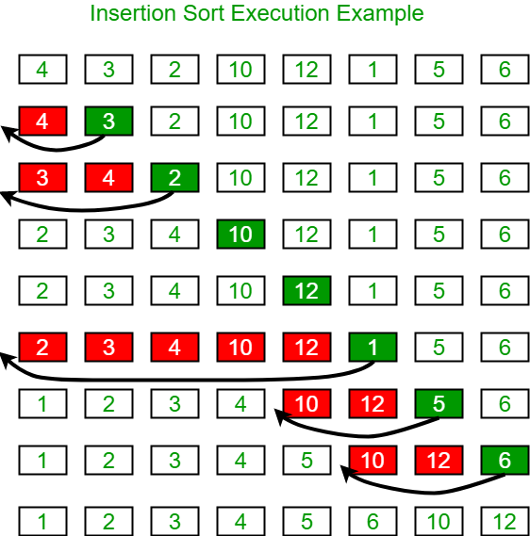
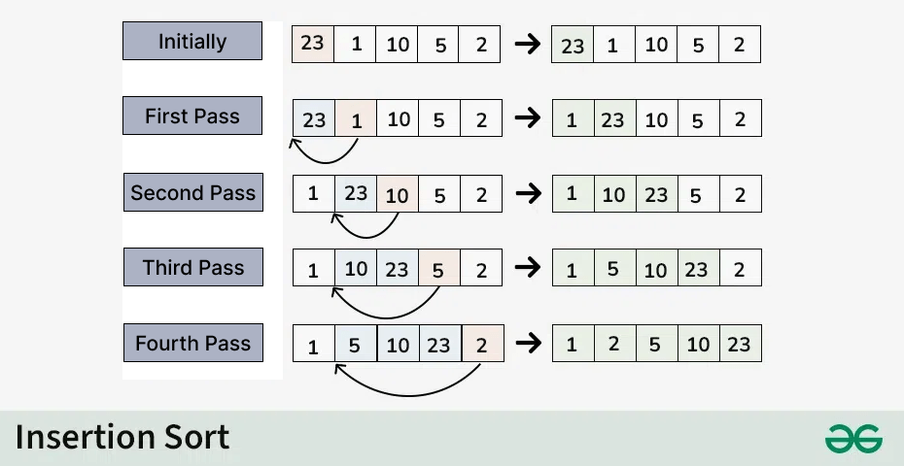
Insertion Sort: More Examples

Slide 14
Selection Sort

Slide 15
Selection Sort
Selection Sort works by repeatedly selecting the smallest element from the unsorted portion and swapping it with the first unsorted element. This process continues until the entire array is sorted
First find the smallest element and swap it with the first element. This way we get the smallest element at its correct position
Then find the smallest among remaining elements (or second smallest) and move it to its correct position by swapping
After k iterations of the loop, the k smallest elements of the array are (sorted) in indices 0, … , k-1
Keep going until all elements are sorted.
Time complexity: O(n²), as there are two nested loops:
Outer loop to select each element one by one with O(n) complexity
Inner loop to compare that element with every other element with O(n) complexity
Selection Sort | GeeksforGeeks
https://www.youtube.com/watch?v=xWBP4lzkoyM
4
7
2
10
1
8
unsorted
1
7
2
10
4
8
sorted
unsorted
1
2
7
10
4
8
sorted
unsorted
1
2
4
10
7
8
Selection Sort: Basic Algorithm
For each position i from 0 to length-2
Find smallest element in positions i to length-1
Swap it with element in position i
1
2
4
7
10
8
1
2
4
7
8
10
which next?
sorted
i
unsorted
Notes:
Selection sort:
After k iterations of the loop, the k smallest elements of the array are (sorted) in indices 0, … , k-1
Runs in O(n²) time no matter what
Using data structures
Speed up our existing ideas
If only we had a data structure that was good at getting the smallest item remaining in our dataset…
We do!

Slide 16
Selection Sort
0 | 1 | 2 | 3 | 4 | 5 | 6 | 7 | 8 | 9
2 | 3 | 6 | 7 | 18 | 10 | 14 | 9 | 11 | 15
Sorted Items
Current Item
Unsorted Items
0 | 1 | 2 | 3 | 4 | 5 | 6 | 7 | 8 | 9
2 | 3 | 6 | 7 | 9 | 10 | 14 | 18 | 11 | 15
Sorted Items
Current Item
Unsorted Items
0 | 1 | 2 | 3 | 4 | 5 | 6 | 7 | 8 | 9
2 | 3 | 6 | 7 | 9 | 10 | 14 | 18 | 11 | 15
Sorted Items
Unsorted Items
Current Item

Slide 17

Selection Sort
0 | 1 | 2 | 3 | 4 | 5 | 6 | 7 | 8 | 9
2 | 3 | 6 | 7 | 18 | 10 | 14 | 9 | 11 | 15
Sorted Items
Current Item
Unsorted Items
public void selectionSort(collection) {
for (entire list)
int newIndex = findNextMin(currentItem);
swap(newIndex, currentItem);
}
public int findNextMin(currentItem) {
min = currentItem
for (unsorted list)
if (item < min)
min = currentItem
return min
}
public int swap(newIndex, currentItem) {
temp = currentItem
currentItem = newIndex
newIndex = currentItem
}
Worst case runtime?
Best case runtime?
Average runtime?
Stable?
In-place?
Useful for:
No
Yes
Top K sort without needing extra space

Slide 18
Selection Sort Stability
0 | 1 | 2 | 3 | 4 | 5 | 6
5a | 3 | 4 | 5b | 2 | 6 | 8
✓
0 | 1 | 2 | 3 | 4 | 5 | 6
2 | 3 | 4 | 5b | 5a | 6 | 8
…
0 | 1 | 2 | 3 | 4 | 5 | 6
2 | 3 | 4 | 5b | 5a | 6 | 8
*Swapping non-adjacent items can result in instability of sorting algorithms

Slide 19
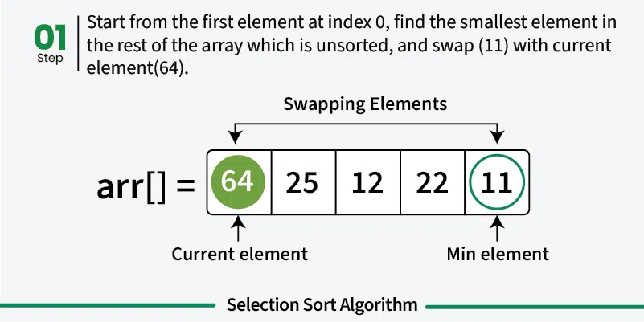
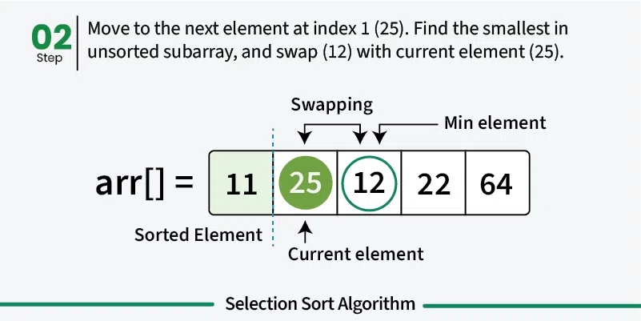
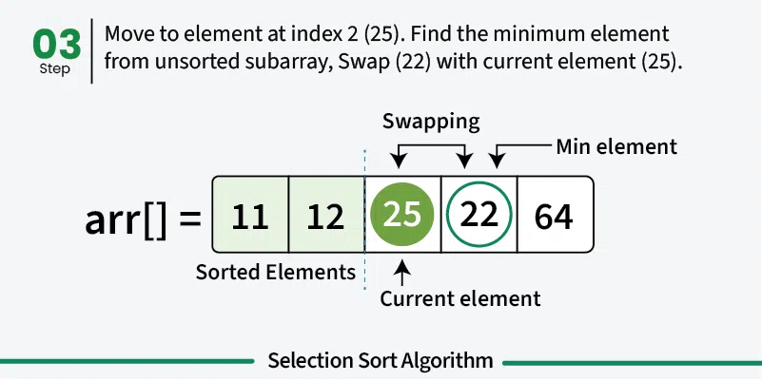
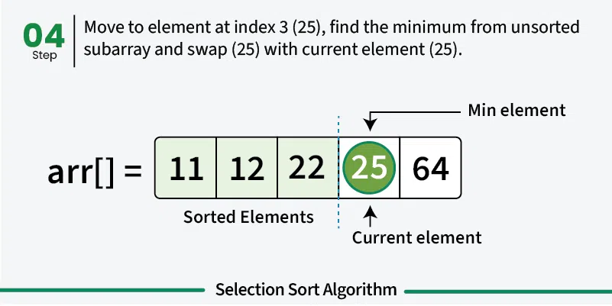
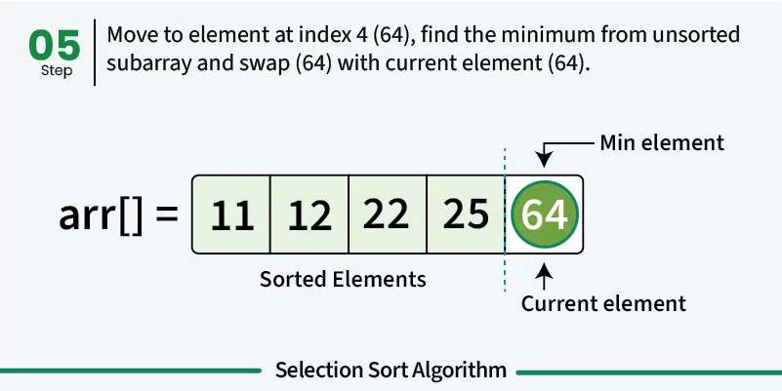
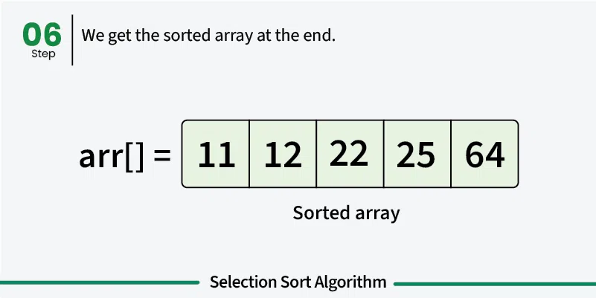

Slide 20
Principle 2: Divide and Conquer
General recipe:
Divide your work into smaller pieces (subproblems) recursively
Conquer the recursive subproblems
In many algorithms, conquering a subproblem requires no extra work beyond recursively dividing and combining it!
Combine the results of your recursive calls
Examples: Merge Sort, Quick Sort
divideAndConquer(input) {
if (small enough to solve):
conquer, solve, return results
else:
divide input into a smaller pieces
recurse on smaller pieces
combine results and return
}
Notes:
Divide and Conquer

Slide 21
Merge Sort

Slide 22

Merge Sort
Merge sort
Divide array into two halves. Recursively sort each half. Merge two halves
Merge Sort Algorithm: A Step-by-Step Visualization, Quoc Dat Phung
https://www.youtube.com/watch?v=ho05egqcPl4
0 | 1 | 2 | 3
55 | 1 | 7 | 6
0 | 1
55 | 1
0 | 1
7 | 6
0
55
0
1
0
7
0
6
0 | 1
1 | 55
0 | 1
6 | 7
input | M | E | R | G | E | S | O | R | T | E | X | A | M | P | L | E
sort left half | E | E | G | M | O | R | R | S | T | E | X | A | M | P | L | E
sort right half | E | E | G | M | O | R | R | S | A | E | E | L | M | P | T | X
merge results | A | E | E | E | E | G | L | M | M | O | P | R | R | S | T | X
0 | 1 | 2 | 3
1 | 6 | 7 | 55
Merge Sort overview
Notes:
breaks down the problem into smaller sub-problems

Slide 23
Merge Sort
Divide
0 | 1 | 2 | 3 | 4 | 5 | 6 | 7
8 | 2 | 91 | 22 | 55 | 1 | 7 | 6
Divide in half each time
0 | 1 | 2 | 3
8 | 2 | 91 | 22
0 | 1 | 2 | 3
55 | 1 | 7 | 6
Conquer
…
0
8
0
2
0
91
0
22
0
55
0
1
0
7
0
6
Combine
…
0 | 1 | 2 | 3
2 | 8 | 22 | 91
0 | 1 | 2 | 3
1 | 6 | 7 | 55
Actual sorting happens here
0 | 1 | 2 | 3 | 4 | 5 | 6 | 7
1 | 2 | 6 | 7 | 8 | 22 | 55 | 91

Slide 24
Merge Sort: Divide Step
Divide
0 | 1 | 2 | 3 | 4 | 5 | 6 | 7
8 | 2 | 91 | 22 | 55 | 1 | 7 | 6
Recursive Case: split the array in half and recurse on both halves
0 | 1 | 2 | 3
8 | 2 | 91 | 22
0 | 1 | 2 | 3
55 | 1 | 7 | 6
0 | 1
8 | 2
0 | 1
91 | 22
0 | 1
55 | 1
0 | 1
7 | 6
When array hits size 1, stop dividing.
0
8
0
2
0
91
0
22
0
55
0
1
0
7
0
6
Sort the pieces through recursion
Notes:
In Merge Sort, no additional work to conquer: everything gets sorted in combine step!

Slide 25
Merge Sort: Combine Step
Combine
0 | 1 | 2 | 3
2 | 8 | 22 | 91
0 | 1 | 2 | 3
1 | 6 | 7 | 55
0 | 1 | 2 | 3 | 4 | 5 | 6 | 7
1
2
6
7
8
22
55
91
Combining two sorted arrays:
Initialize two pointers to start of both arrays
Repeat until all elements are added:
Add the smaller element of the two pointers to the result array
Move that pointer forward one spot
Notes:
Works because we only move the smaller pointer – then ”reconsider” the larger against a new value, and because the arrays are sorted we never have to backtrack!

Slide 26

Merge Sort
n
0 | 1 | 2 | 3
55 | 1 | 7 | 6
mergeSort(list) {
if (list.length == 1):
return list
else:
smallerHalf = mergeSort(new [0, ..., mid])
largerHalf = mergeSort(new [mid + 1, ...])
return merge(smallerHalf, largerHalf)
}
0 | 1
55 | 1
0 | 1
7 | 6
2 log n
0
55
0
1
0
7
0
6
Worst case runtime?
Best case runtime?
In Practice runtime?
Stable?
In-place?
$$O(n log⁡n)$$
0 | 1
1 | 55
0 | 1
6 | 7
Same
Same
0 | 1 | 2 | 3
1 | 6 | 7 | 55
Yes
No
Notes:
(This is what Java uses for Objects, kinda ) Don’t forget your old friends, the 3 recursive patterns!
Predictable sort times regardless of sorted nature

Slide 27
Quick Sort

Slide 28
Quick Sort
Choose a Pivot: Select an element from the array as the pivot. The choice of pivot can vary (e.g., first element, last element, random element, or median)
Partition the Array:
1. The pivot is compared with each element in the array
2. Elements smaller than the pivot are moved to its left
3. Elements larger than the pivot are moved to its right
4. The pivot is placed in its final sorted position
Recursively Call: Recursively apply the same process to the two partitioned sub-arrays (left and right of the pivot).
Base Case: The recursion stops when there is only one element left in the sub-array, as a single element is already sorted.
Quick sort in 4 minutes (recommended)
https://www.youtube.com/watch?v=Hoixgm4-P4M
Notes:
Shuffle the array.
Partition so that, for some pivot j
entry a[j] is in place
no larger entry to the left of j
no smaller entry to the right of j
Sort each piece recursively.
References
QuickSort | geeksforgeeks
https://www.geeksforgeeks.org/quick-sort-algorithm/
Quick sort in 4 minutes (recommended)
https://www.youtube.com/watch?v=Hoixgm4-P4M
Quicksort Algorithm: A Step-by-Step Visualization (recommended)
https://www.youtube.com/watch?v=pM-6r5xsNEY
QUICK SORT | Sorting Algorithms | DSA | GeeksforGeeks
https://www.youtube.com/watch?v=PgBzjlCcFvc
Quicksort
Split into two arrays.
Roughly, elements that are “small” and elements that are “large”
How to define “small” and “large”? Choose a “pivot” value in the array that will partition the two arrays!
Partition Function of Quick Sort | GeeksforGeeks
https://www.youtube.com/watch?v=OwR53k9DZ9c
Quick Sort
Visualization of Quick sort (HD)
https://www.youtube.com/watch?v=aXXWXz5rF64

Slide 29
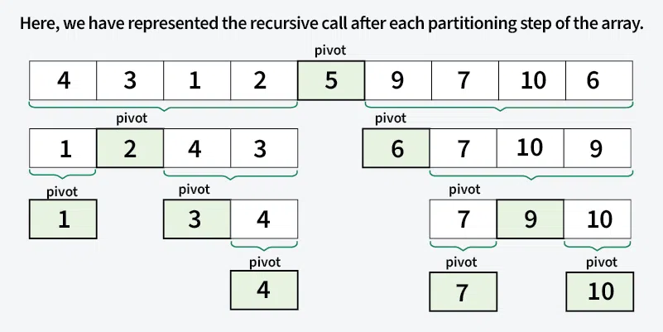
Quick Sort Example
Input array [4, 3, 9, 7, 1, 2, 10, 6, 5]
Choose the last element as pivot
Notes:
Shuffle the array.
Partition so that, for some pivot j
entry a[j] is in place
no larger entry to the left of j
no smaller entry to the right of j
Sort each piece recursively.
References
QuickSort | geeksforgeeks
https://www.geeksforgeeks.org/quick-sort-algorithm/
Quick sort in 4 minutes (recommended)
https://www.youtube.com/watch?v=Hoixgm4-P4M
Quicksort Algorithm: A Step-by-Step Visualization (recommended)
https://www.youtube.com/watch?v=pM-6r5xsNEY
QUICK SORT | Sorting Algorithms | DSA | GeeksforGeeks
https://www.youtube.com/watch?v=PgBzjlCcFvc
Quicksort
Split into two arrays.
Roughly, elements that are “small” and elements that are “large”
How to define “small” and “large”? Choose a “pivot” value in the array that will partition the two arrays!
Partition Function of Quick Sort | GeeksforGeeks
https://www.youtube.com/watch?v=OwR53k9DZ9c
Quick Sort
Visualization of Quick sort (HD)
https://www.youtube.com/watch?v=aXXWXz5rF64

Slide 30
Quick Sort (v1)
Divide
0 | 1 | 2 | 3 | 4 | 5 | 6 | 7
8 | 2 | 91 | 22 | 55 | 1 | 7 | 6
PIVOT
Divide: Choose a “pivot” element, partition array relative to it
0 | 1 | 2 | 3
2 | 1 | 7 | 6
0
8
0 | 1 | 2
91 | 22 | 55
…
Conquer
0
1
0
2
0
6
0
7
0
8
0
22
0
55
0
91
Combine
…
0 | 1 | 2 | 3
1 | 2 | 6 | 7
0
8
0 | 1 | 2 | 3
1 | 6 | 7 | 55
Combine: Concatenate the now-sorted arrays
0 | 1 | 2 | 3 | 4 | 5 | 6 | 7
1 | 2 | 6 | 7 | 8 | 22 | 55 | 91

Slide 31
Quick Sort (v1): Divide Step
Divide
0 | 1 | 2 | 3 | 4 | 5 | 6 | 7
8 | 2 | 91 | 22 | 55 | 1 | 7 | 6
PIVOT
Recursive Case:
Choose a “pivot” element
Partition: linear scan through array, add smaller elements to one array and larger elements to another
Recursively partition
0 | 1 | 2 | 3
2 | 1 | 7 | 6
0
8
PIVOT
0 | 1 | 2
91 | 22 | 55
PIVOT
0
1
0
2
0 | 1
7 | 6
0 | 1
22 | 55
0
91
PIVOT
PIVOT
Base Case:
When array hits size 1, stop dividing
0
6
0
7
0
22
0
55

Slide 32
Quick Sort (v1): Combine Step
Combine
0
6
0
7
0
22
0
55
0
1
0
2
0 | 1
6 | 7
0 | 1
22 | 55
0
91
Simply concatenate the arrays that were created earlier. Partition step already left them in order
0 | 1 | 2 | 3
1 | 2 | 6 | 7
0
8
0 | 1 | 2
22 | 55 | 91
0 | 1 | 2 | 3 | 4 | 5 | 6 | 7
1 | 2 | 6 | 7 | 8 | 22 | 55 | 91

Slide 33
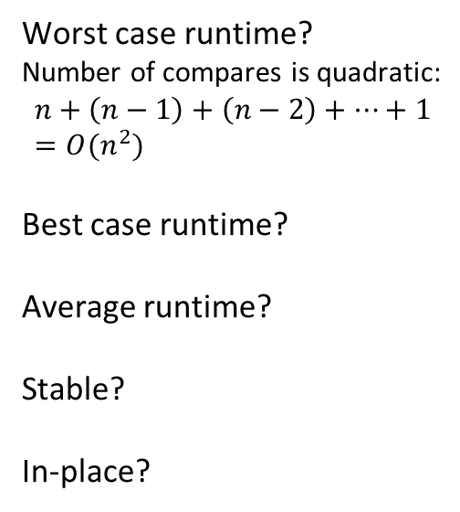



Quick Sort (v1)
Worst case: Pivot only chops off one value
Best case: Pivot divides each array in half
0 | 1 | 2 | 3
2 | 1 | 7 | 6
quickSort(list) {
if (list.length == 1):
return list
else:
pivot = choosePivot(list)
smallerHalf = quickSort(getSmaller(pivot, list))
largerHalf = quickSort(getBigger(pivot, list))
return smallerHalf + pivot + largerHalf
}
PIVOT
0
1
0
2
0 | 1
7 | 6
PIVOT
Worst case runtime?
Number of compares is quadratic:
$$n+\left(n−1\right)+\left(n−2\right)+…+1=O(n^{2})$$
Best case runtime?
Average runtime?
Stable?
In-place?
$$O(n^{2})$$
0
6
0
7
0 | 1
6 | 7
$$O(n\log{n})$$
$$O(n\log{n})$$
0 | 1 | 2 | 3
1 | 2 | 6 | 7
(non-trivial derivation)
No
Can be
Notes:
Fast sorting of primitives!
(This is what Java uses for Primitives)
Pivot divides each array in half each time

Slide 34
Strategies for Choosing a Pivot
Just take the first element
Very fast
But has worst case: for example, sorted lists have Ω(n²) runtime
Take the median of the full array
Can find the median in O(n) time (QuickSelect). It’s complicated
Worst case is O(n log n) … but the constant factors are large. No one does quicksort this way.
Take the median of the first, last, and middle element
Makes pivot slightly more content-aware, at least won’t select very smallest/largest
Worst case is still O(n²) , but on real-world data tends to perform well!
Pick a random element
Get O(n log n) runtime with probability at least 1-1/n²
No simple worst-case input (e.g. sorted, reverse sorted)
Notes:
How to avoid hitting the worst case?
It depends on pivot selection. If the pivot divides each array in half, we get better behavior
Here are four options for finding a pivot. What are the tradeoffs?
Just take the first element
Take the median of the full array
Take the median of the first, last, and middle element
Pick a random element
The pivot is an element chosen from the array that serves as a reference point for partitioning the array into two subarrays. There are several strategies for selecting the pivot:
###First or Last Element as Pivot. Simple to implement but can lead to poor performance if the array is already sorted or nearly sorted.
### Random Element as Pivot. This can help avoid worst-case scenarios and provide more consistent performance across different input distributions.
### Median-of-Three. This method selects the median of the first, middle, and last elements of the array as the pivot. It provides a good balance between simplicity and performance.

Slide 35
Quick Sort (v2: In-Place) Example I
Repeat until i and j pointers cross
Scan i from left to right so long as (a[i] < a[lo]).
Scan j from right to left so long as (a[j] > a[lo]).
Exchange a[i] with a[j].
When pointers cross.
Exchange a[lo] with a[j].
K
R
A
T
E
L
E
P
U
I
M
Q
C
X
O
S
K
R
A
T
E
L
E
P
U
I
M
Q
C
X
O
S
pivot
lo
i
j
j
j
j
K
C
A
T
E
L
E
P
U
I
M
Q
R
X
O
S
lo
i
i
i
j
j
j
j
K
C
A
I
E
L
E
P
U
T
M
Q
R
X
O
S
lo
i
i
i
j
j
j
j
K
C
A
I
E
E
L
P
U
T
M
Q
R
X
O
S
lo
j
i
j
i
E
C
A
I
E
K
L
P
U
T
M
Q
R
X
O
S
lo
j
i
hi
Notes:
Shuffle the array.
Partition so that, for some pivot j
entry a[j] is in place
no larger entry to the left of j
no smaller entry to the right of j
Sort each piece recursively.
References
QuickSort | geeksforgeeks
https://www.geeksforgeeks.org/quick-sort-algorithm/
Quick sort in 4 minutes (recommended)
https://www.youtube.com/watch?v=Hoixgm4-P4M
Quicksort Algorithm: A Step-by-Step Visualization (recommended)
https://www.youtube.com/watch?v=pM-6r5xsNEY
QUICK SORT | Sorting Algorithms | DSA | GeeksforGeeks
https://www.youtube.com/watch?v=PgBzjlCcFvc
Quicksort
Split into two arrays.
Roughly, elements that are “small” and elements that are “large”
How to define “small” and “large”? Choose a “pivot” value in the array that will partition the two arrays!
Partition Function of Quick Sort | GeeksforGeeks
https://www.youtube.com/watch?v=OwR53k9DZ9c
Quick Sort
Visualization of Quick sort (HD)
https://www.youtube.com/watch?v=aXXWXz5rF64

Slide 36
Quick Sort (v2: In-Place) Example II
Divide
0 | 1 | 2 | 3 | 4 | 5 | 6 | 7 | 8 | 9
8 | 1 | 4 | 9 | 0 | 3 | 5 | 2 | 7 | 6
PIVOT?
PIVOT!
PIVOT?
PIVOT?
Select a pivot
0 | 1 | 2 | 3 | 4 | 5 | 6 | 7 | 8 | 9
6 | 1 | 4 | 9 | 0 | 3 | 5 | 2 | 7 | 8
Move pivot out of the way
Bring low and high pointers together, swapping elements if needed
Low
X < 6
High
X >= 6
0 | 1 | 2 | 3 | 4 | 5 | 6 | 7 | 8 | 9
6 | 1 | 4 | 2 | 0 | 3 | 5 | 9 | 7 | 8
Meeting point is where pivot belongs; swap in. Now recurse on smaller portions of same array!
Low
X < 6
High
X >= 6
0 | 1 | 2 | 3 | 4 | 5 | 6 | 7 | 8 | 9
5 | 1 | 4 | 2 | 0 | 3 | 6 | 9 | 7 | 8

Slide 37
Quick Sort is Equivalent to Sorting by BST
Key idea: compareTo calls are same for Binary Search Tree (BST) insert and Quick Sort.
Every number gets compared to 5; 1, 3, 4 get compared to only 2.
Recall: Insertion into a BST has average-case complexity O(N log N)
5
2
6
1
3
9
4
7
10
BST In-order traversal gives sorted list [1,2,3,4,5,6,7,9,10]
Notes:
How to avoid hitting the worst case?
It depends on pivot selection. If the pivot divides each array in half, we get better behavior
Here are four options for finding a pivot. What are the tradeoffs?
Just take the first element
Take the median of the full array
Take the median of the first, last, and middle element
Pick a random element
The pivot is an element chosen from the array that serves as a reference point for partitioning the array into two subarrays. There are several strategies for selecting the pivot:
###First or Last Element as Pivot. Simple to implement but can lead to poor performance if the array is already sorted or nearly sorted.
### Random Element as Pivot. This can help avoid worst-case scenarios and provide more consistent performance across different input distributions.
### Median-of-Three. This method selects the median of the first, middle, and last elements of the array as the pivot. It provides a good balance between simplicity and performance.

Slide 38

Trace of a Quick Sort Example
initial values random shuffle
lo j hi 0 1 2 3 4 5 6 7 8 9 10 11 12 13 14 15
 |  |  | Q | U | I | C | K | S | O | R | T | E | X | A | M | P | L | E
 |  |  | K | R | A | T | E | L | E | P | U | I | M | Q | C | X | O | S
0 | 5 | 15 | E | C | A | I | E | K | L | P | U | T | M | Q | R | X | O | S
0 | 3 | 4 | E | C | A | E | I | K | L | P | U | T | M | Q | R | X | O | S
0 | 2 | 2 | A | C | E | E | I | K | L | P | U | T | M | Q | R | X | O | S
0 | 0 | 1 | A | C | E | E | I | K | L | P | U | T | M | Q | R | X | O | S
1 |  | 1 | A | C | E | E | I | K | L | P | U | T | M | Q | R | X | O | S
4 |  | 4 | A | C | E | E | I | K | L | P | U | T | M | Q | R | X | O | S
6 | 6 | 15 | A | C | E | E | I | K | L | P | U | T | M | Q | R | X | O | S
7 | 9 | 15 | A | C | E | E | I | K | L | M | O | P | T | Q | R | X | U | S
7 | 7 | 8 | A | C | E | E | I | K | L | M | O | P | T | Q | R | X | U | S
8 |  | 8 | A | C | E | E | I | K | L | M | O | P | T | Q | R | X | U | S
10 | 13 | 15 | A | C | E | E | I | K | L | M | O | P | S | Q | R | T | U | X
10 | 12 | 12 | A | C | E | E | I | K | L | M | O | P | R | Q | S | T | U | X
10 | 11 | 11 | A | C | E | E | I | K | L | M | O | P | Q | R | S | T | U | X
10 |  | 10 | A | C | E | E | I | K | L | M | O | P | Q | R | S | T | U | X
14 | 14 | 15 | A | C | E | E | I | K | L | M | O | P | Q | R | S | T | U | X
15 |  | 15 | A | C | E | E | I | K | L | M | O | P | Q | R | S | T | U | X
 |  |  | A | C | E | E | I | K | L | M | O | P | Q | R | S | T | U | X
no partition for subarrays of size 1
result
Quick Sort trace (array contents after each partition)
Notes:
When the list is randomly shuffled:
If we always pick the middle element as the pivot, then Quick Sort has the best-case complexity of O(n log n). This corresponds to a balanced BST.
How to avoid hitting the worst case?
It depends on pivot selection. If the pivot divides each array in half, we get better behavior
Here are four options for finding a pivot. What are the tradeoffs?
Just take the first element
Take the median of the full array
Take the median of the first, last, and middle element
Pick a random element
The pivot is an element chosen from the array that serves as a reference point for partitioning the array into two subarrays. There are several strategies for selecting the pivot:
###First or Last Element as Pivot. Simple to implement but can lead to poor performance if the array is already sorted or nearly sorted.
### Random Element as Pivot. This can help avoid worst-case scenarios and provide more consistent performance across different input distributions.
### Median-of-Three. This method selects the median of the first, middle, and last elements of the array as the pivot. It provides a good balance between simplicity and performance.

Slide 39

Best-Case vs. Worst-Case
When the list is randomly shuffled, and if we happen to always pick the median element as the pivot, then Quick Sort has the best-case complexity of O(n log n). This corresponds to a balanced BST
When the list is already sorted, and if we always pick the first element as the pivot, then Quick Sort has the worst-case complexity of O(n²). This corresponds to a extremely unbalanced BST.
Notes:
When the list is randomly shuffled:
If we always pick the middle element as the pivot, then Quick Sort has the best-case complexity of O(n log n). This corresponds to a balanced BST.
How to avoid hitting the worst case?
It depends on pivot selection. If the pivot divides each array in half, we get better behavior
Here are four options for finding a pivot. What are the tradeoffs?
Just take the first element
Take the median of the full array
Take the median of the first, last, and middle element
Pick a random element
The pivot is an element chosen from the array that serves as a reference point for partitioning the array into two subarrays. There are several strategies for selecting the pivot:
###First or Last Element as Pivot. Simple to implement but can lead to poor performance if the array is already sorted or nearly sorted.
### Random Element as Pivot. This can help avoid worst-case scenarios and provide more consistent performance across different input distributions.
### Median-of-Three. This method selects the median of the first, middle, and last elements of the array as the pivot. It provides a good balance between simplicity and performance.

Slide 40
Heap Sort

Slide 41



Heap Sort
1. Run Floyd’s buildHeap
2. Call removeMin n times
public void heapSort(input) {
E[] heap = buildHeap(input)
E[] output = new E[n]
for (n)
output[i] = removeMin(heap)
}
Worst case runtime?
Best case runtime?
Average runtime?
Stable?
In-place?
$$O\left(n\log{n}\right)$$
$$O\left(n\right)$$
$$O\left(n\log{n}\right)$$
No
Yes

Slide 42
In Place Heap Sort
0 | 1 | 2 | 3 | 4 | 5 | 6 | 7 | 8 | 9
1 | 4 | 2 | 14 | 15 | 18 | 16 | 17 | 20 | 22
Heap
Sorted Items
Current Item
0 | 1 | 2 | 3 | 4 | 5 | 6 | 7 | 8 | 9
22 | 4 | 2 | 14 | 15 | 18 | 16 | 17 | 20 | 1
percolateDown(22)
Heap
Sorted Items
Current Item
0 | 1 | 2 | 3 | 4 | 5 | 6 | 7 | 8 | 9
2 | 4 | 16 | 14 | 15 | 18 | 22 | 17 | 20 | 1
Heap
Sorted Items
Current Item

Slide 43



In Place Heap Sort
0 | 1 | 2 | 3 | 4 | 5 | 6 | 7 | 8 | 9
15 | 17 | 16 | 18 | 20 | 22 | 14 | 4 | 2 | 1
Heap
Sorted Items
Current Item
public void inPlaceHeapSort(input) {
buildHeap(input) // alters original array
for (n : input)
input[n – i - 1] = removeMin(heap)
}
Worst case runtime?
Best case runtime?
Average runtime?
Stable?
In-place?
$$O\left(n\log{n}\right)$$
$$O\left(n\right)$$
$$O\left(n\log{n}\right)$$
Complication: final array is reversed! Lots of fixes:
Run reverse afterwards O(n)
Use a max heap
Reverse compare function to emulate max heap
No
Yes

Slide 44
Bucket Sort

Slide 45
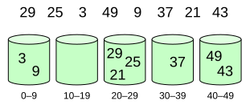
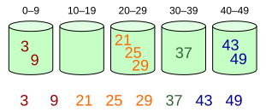
Bucket Sort
Bucket sort is a comparison sort algorithm that works by distributing the elements of an array into a number of buckets and then each bucket is sorted individually using a stable sorting algorithm, e.g., Insertion Sort or Merge Sort.
This algorithm is efficient when the input is uniformly distributed over a range.
Elements are distributed among bins
Bucket Sort | GeeksforGeeks
https://www.youtube.com/watch?v=VuXbEb5ywrU
Then, elements are sorted within each bin
https://en.wikipedia.org/wiki/Bucket_sort

Slide 46
Bucket Sort (aka Bin Sort)
If all values are ints known to be in the range of 1 - K
Create array of size K and put each element in its proper bucket (“scatter”)
If elements are only ints simply store count of ints in each bucket
Output results via linear pass through array of buckets (“gather”)
[5, 1, 3, 4, 3, 2, 1, 1, 5, 4, 5]
1 | 3
2 | 1
3 | 2
4 | 4
5 | 3
O(K + n)
O(n)
[1, 1, 1, 2, 3, 3, 4, 4, 5, 5, 5]
Total Runtime: O(K + n)

Slide 47
Bucket Sort with Data
Bucket Sort | GeeksforGeeks
https://www.youtube.com/watch?v=VuXbEb5ywrU
Make buckets of array of lists
Put items into bucket, use insertion sort to sort individual buckets
[0.78, 0.17, 0.39, 0.26, 0.72, 0.94, 0.21, 0.12, 0.23, 0.68]
0
1
2
3
4
5
6
7
8
9
0
1
2
3
4
5
6
7
8
9
0.17
0.12
0.12
0.17
O(n)
0.26
0.21
0.23
0.21
0.23
0.26
0.39
0.39
worst: O(K + n²)
best: O(K)
O(K + n)
0.68
0.68
0.78
0.72
0.72
0.78
[0.12, 0.17, 0.21, 0.23, 0.26, 0.39, 0.68, 0.72, 0.78, 0.94]
0.94
0.94

Slide 48
Bucket Sort
function bucketSort(array, k) is
buckets ← new array of k empty lists
M ← 1 + the maximum key value in the array
for i = 0 to length(array) do
insert array[i] into buckets[floor(k × array[i] / M)]
for i = 0 to k do
nextSort(buckets[i])
return the concatenation of buckets[0], ...., buckets[k]
Worst case runtime?
Best case runtime?
Average runtime?
Stable?
In-place?
Useful for:
O(K + n) for ints
O(K + n²) for data if insertion sort is used
O(n)
O(n) if K ≅ n, always for ints, and if values are evenly distributed for data
Can be because insertion sort
No
When range, K, is smaller or not much larger than n (not many duplicates)
Not good when K >> N, wasted space

Slide 49
Heap Sort
Bucket Sort
Radix Sort
Sorting Summary

Slide 50
Specialized Sorts (“Niche Sorts”)
So far we’ve learned about comparison sorts
work on any comparable object
have a best case lower bound of O(n log n)
This is because to sort using comparisons requires all elements to be compared against one another
n runtime to process all values into some ordered structure (tree)
O(log n) runtime to remove items from structure in sorted order
What if we didn’t need to compare each element, what if we built a sort based on inherent knowledge about the ordering of numbers?
Specialized Sorts: Sorting algorithms that only work on data types with ordering already known to computer logic: numbers
Bucket Sort for ints
Radix Sort
Notes:
Sorting algorithms that only work on data types with ordering already known to computer logic: numbers
Bucket Sort for ints
Radix Sort

Slide 51
Radix and Radix Sort
Radix = “The base of a number system”
Number of unique digits, including the digit zero, used to represent numbers
Radix of numbers:
Binary numbers have a radix of 2
decimals have a radix of 10
hexadecimals have a radix of 16
Radix sort was first used in 1890 U.S. census by Hollerith
Efficient O(n) complexity
Not in-place sorting
May use more space than other sorting algorithms
Basic idea: Bucket sort on each digit, from least significant digit to most significant digit.
Notes:
Radix is another term of “base”: E.g., bubble sort is in-place sorting.
when sorting a large number of elements
O(n). n: number of elements; k: number of digits in the largest number

Slide 52
Radix Sort Algorithm
radix_sort(A, n, k) {
/* A: array; n: number of elements; k: number of digits in the largest number */
create buckets (buckets can be arrays or lists)
for (d = 0; d <k; d++) {
/* sort A using digit position d as the key. */
for (i = 0; i<n; i++) {
p = the d-th digit (from right) of A[i]
Add A[i] to bucket p
}
A = Join the buckets
}
}
Time complexity O(n)

Slide 53
Bucket Sort as used in Radix Sort
Use bucket array of size R for radix of R
Put elements into the correct bucket in the array
R = 5; unique digits (0,1,2,3,4); list = (0,1,3,4,3,2,1,1,0,4,0)
Buckets
= 0 | 0,0,0
= 1 | 1,1,1
= 2 | 2
= 3 | 3,3
= 4 | 4,4
Sorted list:
0,0,0,1,1,1,2,3,3,4,4

Slide 54
Radix Sort: bucket sort on every digit/bit
For N elements between (L, H), using H-L+1 buckets can sort the elements in one round
Problem: the range (L, H) may be too large.
Sorting 4-byte unsigned integers, range is [0, 2³²-1] → 2³² buckets
Solution(radix sort): apply bucket sort on every digit/bit
2
0
5
1
7
3
4
6
0 1 0
0 0 0
1 0 1
0 0 1
1 1 1
0 1 1
1 0 0
1 1 0
Use two buckets 0 and 1

Slide 55
2
0
5
1
7
3
4
6
0 1 0
0 0 0
1 0 1
0 0 1
1 1 1
0 1 1
1 0 0
1 1 0
0
0 1 0
0 0 0
1 0 0
1 1 0
1 0 1
0 0 1
1 1 1
0 1 1
0 1 0
0 0 0
1 0 0
1 1 0
Merge
Step 1: Sort by the least significant bit
1
1 0 1
0 0 1
1 1 1
0 1 1
2
0
5
1
7
3
4
6
0 1 0
0 0 0
1 0 0
1 1 0
1 0 1
0 0 1
1 1 1
0 1 1
0
0 0 0
1 0 0
1 0 1
0 0 1
0 1 0
1 1 0
1 1 1
0 1 1
0 0 0
1 0 0
1 0 1
0 0 1
Step 2. Sort by the middle bit
Merge
1
0 1 0
1 1 0
1 1 1
0 1 1

Slide 56
2
0
5
1
7
3
4
6
0 0 0
1 0 0
1 0 1
0 0 1
0 1 0
1 1 0
1 1 1
0 1 1
0
0 0 0
0 0 1
0 1 0
0 1 1
1 0 0
1 0 1
1 1 0
1 1 1
0
1
2
3
4
5
6
7
0 0 0
0 0 1
0 1 0
0 1 1
Step 3. Sort by the most significant bit
Merge
1
1 0 0
1 0 1
1 1 0
1 1 1
Radix Sort Algorithm Introduction in 5 Minutes, CS Dojo
https://www.youtube.com/watch?v=XiuSW_mEn7g
Radix Sort Animations | Data Structure | Visual How
https://www.youtube.com/watch?v=Om4BljCs_qE
Notes:
Radix Sort Algorithm Introduction in 5 Minutes, CS Dojo
https://www.youtube.com/watch?v=XiuSW_mEn7g

Slide 57
You can choose an appropriate radix value
Numbers in different formats
decimal whole numbers: (126, 328, 636, 341, 416, 131, 328)
Binary numbers: (0 001 111 110, 0 ‭101 001 000, 1 001 111 100‬, ‭0 101 010 101,
‭ 0 110 100 000, ‭0 010 000 011‬‬‬, ‭0 101 001 000)‬
Octal numbers: (0176, 0510, 1174, 0525, 0640, 0203, 0510)
Hexadecimal numbers: (07E, 148, 27C, 1A0, 083, 148)
Radix sort of decimal numbers using ten buckets: 0 to 9
329
416
126
636
328
131
341
341
131
126
636
416
328
329
416
126
328
329
131
636
341
126
131
328
329
341
416
636
043
009
817
412
051
033
071
051
071
412
043
033
817
009
009
412
817
033
043
051
071
009
033
043
051
071
412
817
Example 1
Example 2
Notes:
For the above examples, how many buckets are needed? And how many passes must be made?
Sort by the least significant digit: 341, 131, 126, 636, 416, 328, 328
Sort by the middle digit: 416, 126, 328, 328, 131, 636, 341
Sort by the most significant digit: 126, 131, 328, 328, 341, 416, 636

Slide 58
Radix Sort Example
[478, 537, 9, 721, 3, 38, 143, 67]
[721, 3, 143, 537, 67, 478, 38, 9]
[3, 9, 721, 537, 38, 143, 67, 478]
0
1 | 721
2
3 | 3, 143
4
5
6
7 | 537, 67
8 | 478, 38
9 | 9
0 | 03, 09
1
2 | 721
3 | 537, 38
4 | 143
5
6 | 67
7 | 478
8
9
0 | 003, 009, 038, 067
1 | 143
2
3
4 | 478
5 | 537
6
7 | 721
8
9
O(n)
O(n)
O(n)
O(n)
O(n)
O(n)
[3, 9, 38, 67, 143, 478, 537, 721]

Slide 59
Radix Sort Time Complexity
Worst case runtime?
Best case runtime?
Average runtime?
Stable?
In-place?
Useful for:
O(n)
O(n)
O(n)
Yes
No
Sorting ints

Slide 60
Sorting Summary

Slide 61
Sorting: Summary
No single sorting algorithm is “the best”!
Different algos have different properties in different situations
The best one is one that is well-suited to your data
 | Best-Case | Worst-Case | Space | Stable
Selection Sort | O(n²) | O(n²) | O(1) | No
Insertion Sort | O(n) | O(n²) | O(1) | Yes
Heap Sort | O(nlogn) | O(nlogn) | O(n) | No
In-Place Heap Sort | O(nlogn) | O(nlogn) | O(1) | No
Merge Sort | O(nlogn) | O(nlogn) | O(nlogn) O(n)* optimized | Yes
Quick Sort | O(nlogn) | O(n²) | O(n) | No
In-place Quick Sort | O(nlogn) | O(n²) | O(1) | No
Bucket Sort | O(n) | O(n²) | O(K+n) | Yes
Radix | O(n) | O(n) | O(n) | Yes
Notes:
What does Java do?
A combination of 3 different sorts:
If objects: use Merge Sort* (stable!)
If primitives: use Dual Pivot Quick Sort
For short arrays, use Insertion Sort
* They actually use Tim Sort, which is very similar to Merge Sort in theory, but has some minor details different

Slide 62
References I
Insertion Sort | GeeksforGeeks
https://www.geeksforgeeks.org/insertion-sort-algorithm/
https://www.geeksforgeeks.org/time-and-space-complexity-of-insertion-sort-algorithm/
https://www.youtube.com/watch?v=OGzPmgsI-pQ
Selection Sort | GeeksforGeeks
https://www.geeksforgeeks.org/selection-sort-algorithm-2/
https://www.geeksforgeeks.org/time-and-space-complexity-analysis-of-selection-sort/
https://www.youtube.com/watch?v=xWBP4lzkoyM
Merge Sort Algorithm: A Step-by-Step Visualization, Quoc Dat Phung
https://www.youtube.com/watch?v=ho05egqcPl4
Merge sort in 3 minutes
https://www.youtube.com/watch?v=4VqmGXwpLqc
Merge Sort Algorithm: A Step-by-Step Visualization (recommended)
https://www.youtube.com/watch?v=ho05egqcPl4
Merge Sort Animations | Data Structure | Visual How
https://www.youtube.com/watch?v=spVhtO_IcGg

Slide 63
References II
Quicksort: Partitioning an array, KC Ang
https://www.youtube.com/watch?v=MZaf_9IZCrc
QuickSort | geeksforgeeks
https://www.geeksforgeeks.org/quick-sort-algorithm/
https://www.youtube.com/watch?v=PgBzjlCcFvc
Quick sort in 4 minutes (recommended)
https://www.youtube.com/watch?v=Hoixgm4-P4M
Quicksort Algorithm: A Step-by-Step Visualization (recommended)
https://www.youtube.com/watch?v=pM-6r5xsNEY
Visualization of Quick sort (HD)
https://www.youtube.com/watch?v=aXXWXz5rF64
Notes:
QuickSort | geeksforgeeks
https://www.geeksforgeeks.org/quick-sort-algorithm/
Quick sort in 4 minutes (recommended)
https://www.youtube.com/watch?v=Hoixgm4-P4M
Quicksort Algorithm: A Step-by-Step Visualization (recommended)
https://www.youtube.com/watch?v=pM-6r5xsNEY
QUICK SORT | Sorting Algorithms | DSA | GeeksforGeeks
https://www.youtube.com/watch?v=PgBzjlCcFvc

Slide 64
References III
Radix Sort Algorithm Introduction in 5 Minutes, CS Dojo
https://www.youtube.com/watch?v=XiuSW_mEn7g
Radix Sort Animations | Data Structure | Visual How
https://www.youtube.com/watch?v=Om4BljCs_qE
Radix Sort
https://www.geeksforgeeks.org/radix-sort/
https://www.geeksforgeeks.org/time-and-space-complexity-of-radix-sort-algorithm/
Bucket Sort | GeeksforGeeks
https://www.geeksforgeeks.org/bucket-sort-2/
https://www.youtube.com/watch?v=VuXbEb5ywrU
Time Complexities of all Sorting Algorithms
https://www.geeksforgeeks.org/time-complexities-of-all-sorting-algorithms/

Slide 65
References IV
Sort Algos // Michael Sambol Michael Sambol
https://www.youtube.com/playlist?list=PL9xmBV_5YoZOZSbGAXAPIq1BeUf4j20pl
Merge Sort, Quick Sort, Bubble Sort, Insertion Sort, Selection Sort, Heap Sort
10 Sorting Algorithms Easily Explained
https://www.youtube.com/watch?v=rbbTd-gkajw
Bubble Sort, Selection Sort, Insertion Sort, Merge Sort, Quick Sort, Heap Sort, Counting Sort, Shell Sort, Tim Sort, Radix Sort

Slide 66
Full-Length Lectures
[CSE 373 WI24] Lecture 19: Introduction to Sorting
https://www.youtube.com/watch?v=xCezN9A7yhQ&list=PLEcoVsAaONjd5n69K84sSmAuvTrTQT_Nl&index=18
[CSE 373 WI24] Lecture 20: More Sorting Algorithms
https://www.youtube.com/watch?v=9wVXtKko5CM&list=PLEcoVsAaONjd5n69K84sSmAuvTrTQT_Nl&index=19

